Slide 1


Object. Array. String. Map & Set JSON

Slide 2
function foo (name){
console.log(name)
}
foo(‘Jon Snow’) //Jon Snow
function foo (){
console.log(arguments)
}
foo(‘Mike’,’Ted’) //[‘Mike’,’Ted’]
alert(foo());
function foo() { return 5; }
//Valid syntax as function foo defined
//As declaration and is loaded before
//code execution
alert(foo());
const foo = function() { return 5; }
// ERROR! Defined as expression and
//isn’t loaded yet
Functions
Function Declarations vs. Function Expressions
In javascript all functions – simple data like string or integer.
Functions have parameter ‘arguments’ – array of argument function was invoked with.
Function Declaration and Function Expression
Function can be defined using Declaration or Expression.
Function declarations are loaded before any code is executed.
Function expressions are loaded while reaching line of code
Notes:
https://es6console.com/

Slide 3
function foo (name){
return `Hello ${name}`
}
foo(‘Tom’); //Hello Tom
function foo (name, surname, age){
...
}
foo.length // 3
foo.name // “foo”
let sum = (a, b) => a + b;
Functions
Functions can return value
By default function returns undefined
Function properties :
1) name – Name of function;
2) length – arguments length
new Function
let sum = new Function('a,b', ' return a+b; ');
let result = sum(1, 2);
Is used in cases when function body should be generated
dynamically…
Arrow functions
let sum = (a, b) => a + b;
Have no this, arguments, can’t be invoked with new
Notes:
https://es6console.com/

Slide 4
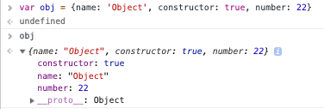
// bad
const car = new Object();
//good
const car = {};
cr.make = ‘BMW’
const car = {
make: ‘Nissan’,
color:’silver’,
};
Object
Objects are variables and contain many values ( properties ).
For instance car is objects and its properties are color , max speed , weight...
Object can be created using object constructor
const car = new Object();
car.make = “Honda”
And using object literal
const car = {
make:”Honda”
}
Notes:
https://es6console.com/

Slide 5
const car = {
make:’BMW’,
model:’3’,
color:’black’
};
Object.keys(car)
//[‘make’,’model’,’color’]
Object.values(car)
//[‘BMW’,’3’,’black’]
Object.entries(car)
[
[‘make’,’BMW’],
[‘model’,’3’],
[‘color’,’black’]
]
Object
For manipulating with object properties and values You can use those methods:
Object.keys() – returns list of object properties;
Object.values() – returns list of values;
Object.entries() – returns list of arrays with 2 items :
propertie ->value
Loop through object:
for (key in car) {
const value = car[key]
}
Object.keys(car).map(key=>{
const value = car[key]
})
Notes:
https://es6console.com/

Slide 6
const first = {a: 1, b: 2};
const second = {c: 3, d: 4};
Object.assign(first, second)
// {a: 1, b: 2, c: 3, d: 4}
first = second;
Object.assign(first, {b: 3});
// {a: 1, b: 3, c: 3, d: 4}
second;
// {a: 1, b: 3, c: 3, d: 4}
user.sayHi = function() { console.log("Hello!"); }; user.sayHi(); // Hello!
Object methods
The Object.assign() method is used to copy the values of all enumerable own properties from one or more source objects to a target object. It will return the target object.
The Object.preventExtensions() method prevents new properties from ever being added to an object (i.e. prevents future extensions to the object).
The hasOwnProperty() method returns a boolean indicating whether the object has the specified property as its own property (as opposed to inheriting it) first.hasOwnProperty(‘a’) // true

Slide 7
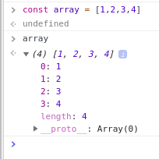

// bad
const array = new Array();
// good
const array = [];
array.push(1) // 1
array.push(‘string’) // 2
array.push({a: 1, b: 2}) // 3
array.push(function(a){return a + 1}) // 4
[1, ‘string’, {...}, fn];
array[0] => 1;
array[3](4) => 5;
Array
JavaScript arrays are used to store multiple values in a single variable.

Slide 8
Array methods
const arr = [1, 2, 3, 4, 5];
The push() method adds one or more elements to the end arr.push(6) // [1, 2, 3, 4, 5, 6]; of an array and returns the new length of the array.
The pop() method removes the last element from an array arr.pop() // [1, 2, 3, 4, 5]; and returns that element. This method changes the length of the array.
The unshift() method adds one or more elements to the arr.unshift(0) // [0, 1, 2, 3, 4, 5]; beginning of an array and returns the new length of the array.
The shift() method removes the first element from arr.shift() // [1, 2, 3, 4, 5]; an array and returns that removed element. This method changes the length of the array.

Slide 9
Array methods
const arr = [1, 2, 3, 4, 5];
The Array.isArray() method determines whether the Array.isArray([1, 2, 3]); // true passed value is an Array.
The find() method returns the value of the first element in arr.find(elem => elem > 2) // 3 the array that satisfies the provided testing function.
The sort() method sorts the elements of an array in place let months = ['March', 'Jan', 'Feb', 'Dec'];
and returns the sorted array.months.sort(); // ["Dec", "Feb", "Jan", "March"]
The splice() method changes the contents of an array by months.splice(1, 0, 'Sep'); removing or replacing existing elements and/or adding // ["March", "Sep", "Jan", "Feb", "Dec"]
new elements.

Slide 10
Array methods
const arr = [1, 2, 3, 4, 5]; arr[0] // 1
arr.length // 5 arr[0] = 6 // [6, 2, 3, 4, 5]
The filter() method creates a new array with all elements arr.filter(item => item > 2) that pass the test implemented by the provided function. // [6,4,5]
The map() method creates a new array with the results arr.map(item => item * 2) of calling a provided function on every element in the // [12, 4, 6, 8, 10] calling array.
note: filter and map return new array
The reduce() method applies a function against arr.reduce((accumulator, currentValue) => an accumulator and each element in the array accumulator + currentValue); (from left to right) to reduce it to a single value.

Slide 11
Array methods
The forEach() method executes a provided function arr.forEach((item) => { once for each array element. console.log(‘item => ‘ + item)});
The some() method tests whether at least one element in const devs = [‘John’,‘Kianu’,‘Deadpool’] the array passes the test implemented by the provided devs.some(item => item === ‘Deadpool’); function. //true
The every() method tests whether all elements in the array devs.every(item => typeof item === ‘string’) pass the test implemented by the provided function. //true

Slide 12
Special characters
Strings
Code | Out
\’ | single quotes
\” | double quotes
\\ | backslash
\n | new line
\uXXXX | unicode codepoint
JavaScript strings are used for storing and manipulating text.
Strings can be enclosed within either single quotes, double quotes or backticks:
const single = 'single-quoted';
const double = "double-quoted";
const backticks = `backticks`;
"\u00A9" // © ‘2’ + 1 // ‘21’
‘2’+ ‘a’ // ‘2a’ +‘2’ + 1 // 3
Notes:
http://1.bp.blogspot.com/-wx_KTJQArqQ/UaURmk-mKGI/AAAAAAAAAg4/SWiaYKBcuPE/s800/base64_encoding_table.gif

Slide 13
Trim method removes (“trims”) spaces from the beginning and end of the string.
' js string '.trim() // ‘js string’
There are 3 methods in JavaScript to get a substring: substring, substr and slice.
str.slice(start [, end]) returns the part of the string from start to (but not including) end.
'string'.slice(0, 3) // ‘str’
'string'.slice(3) // "ing"
str.substring(start [, end]) returns the part of the string between start and end.
'string'.substring(0, 3) // ‘str’
str.substr(start [, length]) returns the part of the string from start, with the given length.
'string'.substr(1, 2) // "tr"
Strings methods
const str = 'string';
str.toUpperCase() // ‘STRING’
‘STRING’.toLowerCase() // ‘string’
str.length // 6
str.indexOf(‘r’) // 2
str.includes(‘r’) // true
// get first character
str[0] // ‘s’
str.charAt(‘s’) // ‘s’
'string'.replace(‘g’,’gs’) // "strings"

Slide 14
Quick questions
const str = ‘string’
str.indexOf(‘i’)
str[0]
str.toLowerCase()
str.slice(2, 3)
str.charAt(0)
const array = [1, 2, 4, 5]
array.pop()
array[2] = 3;
array.unshift(6)
array.shift()
array.length

Slide 15


Slide 16
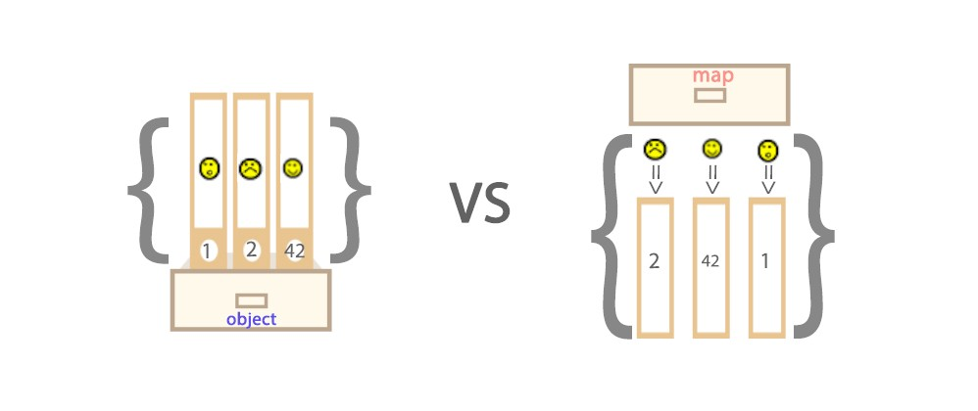
var map = new Map([[1,2],[3,4]]);
console.log(map instanceof Object); //true
var obj = new Object();
console.log(obj instanceof Map); //false
Map vs Object
Notes:
Key field: in Object, it follows the rule of normal dictionary. The keys MUST be simple types — either integer or string or symbols. Nothing more. But in Map it can be any data type (an object, an array, etc…). Element order: in Map, original order of elements (pairs) is preserved, while in Object, it isn’t. Inheritance: Map is an instance of Object (surprise surprise!), but Object is definitely not an instance of Map.

Slide 17
// create Map([iterable])
var map = new Map([[1, '2'], [2, '3']]);
// Map(2) {"1 => 1, "2" => 3}
// get value by key
map.get(1) //’2’
// get keys
map.keys() // {1, 2}
// get values
map.values() // {‘2’, ‘3’}
// set value
map.set(4, 5) // {1 => "2", 2 => "3", 4 => 5}
// remove item map.delete(1) // true
// clear
map.clear() // Map(0) {}
Map
Can be set any value as a key (Array, Object, String, Boolean, etc...)
Easily to know size of Map
Easily to get and set value
Easily to delete one or clear all items
Supported chains
Support iterations methods - keys, values, entries
Notes:
Obj vs Map https://medium.com/front-end-weekly/es6-map-vs-object-what-and-when-b80621932373

Slide 18
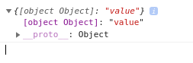
const value = {color:’green’}
const key = {type:’color’}
var map = new Map();
map.set(key, value);
map.get(key) //{color:’green’}
const objectMap = {}
objectMap[key] = value;
objectMap[key] // {color:’green’}
But :
const key2 = {color:’black’}
objectMap[key2] = ‘Black Kolor’;
objectMap[key] //‘Black Kolor’;
Map
Simple objects are valid for map keys too.
But we are not able to use objects as keys inside another objects
const map = {};
const key = {number:’1’};
map[key] = ‘numberset’ is
equal to map["[object Object]"]
Notes:
Obj vs Map https://medium.com/front-end-weekly/es6-map-vs-object-what-and-when-b80621932373

Slide 19

сonst set = new Set([1]);
console.log(set instanceof Object);
//true
сonst arr = new Array(1);
console.log(arr instanceof Object);
//true
console.log(set[0]); //undefined
console.log(arr[0]); //1
Set vs Array
Notes:
One of the biggest differences here, you may notice, is that elements in Array can be duplicate (unless you tell it not to be), and in Set, they just can’t
Array is considered as “indexed collection” type of data structure, while Set is considered as “keyed collection”.
Map is a data collection type

Slide 20
// create Set
const set = new Set(); // Set(0) {}
new Set([1,2,3]) // Set(3) {1,2,3}
const a = ‘a’;
const b = {a: 1};
const c = [1];
s.add(a);
s.add(b);
s.add(c);// Set(3) {‘a’, {...}, Array(1)}
// check if property exist
set.has(b) || set.has(‘a’) //true
// remove item set.delete(a) // true
// clear
set.clear() // Set(0) {}
Set
A set is a collection of data where duplicates are not allowed. The alternative of the set is the array, but it have a worse performance then set.
As argument for creating new instance of set
You can use only iterable object ( Arrays ) new Set([1,2,3,5,1,2,9])
Notes:
Set vs Array
https://medium.com/front-end-weekly/es6-set-vs-array-what-and-when-efc055655e1a

Slide 21
const student = {
name: 'John',
age: 30,
isAdmin: false,
courses: ['html', 'css', 'js'],
wife: null
};
const json = JSON.stringify(student);
console.log(typeof json); // string
console.log(json);
JSON: Stringify
JSON stands for JavaScript Object Notation
is a lightweight format for storing and transporting data
is often used when data is sent from a server to a web page
is "self-describing" and easy to understand
JSON.stringify() to convert objects into JSON.

Slide 22
const user = `{
"name": "John",
"age": 35,
"isAdmin": false,
"friends": [0,1,2,3]
}`; const json = JSON.parse(user); json.friends[1]; // 1
JSON: Parse
JSON.parse() to convert JSON back into an object

Slide 23
Hometask
From 's=t=r=i=n=g' create array ["S", "T", "R", "I", "N", "G"]. Use strings methods.
Create an empty object user. Add the property name with the value John. Add method which takes surname and show message ‘Hello, my name is Name Surname’.
Write method which determines whether an array/string includes a certain value among its entries, returning true or false as appropriate.
Advanced
const arr = ["Adam", "Alex","Monte", "Aaron", "Ben", "Carl", "Dan", "Tim","David", "Edward", "Fred", "Frank", "George", "Hal", "Ike", "John", "Alex","Jack", "Joe", "Larry", "Monte", "Matthew", "Mark", "Nathan", "Otto", "Peter", "Roger", "Steve", "Ben","Thomas", "Tim", "Ty", "Victor", "Walter"].
1. From given array try to get another array only with name which have more than 4 symbols.
2. From array from 1 task create another array with unique values;
3. Use array from task 2. Find count of all ‘o’ letter in array;
( reduce and split can help You )
4. Try to write Your own map method. Should work as origin map method.

Slide 24
Links
https://developer.mozilla.org/en-us/docs/Web/JavaScript/Reference/Global_Objects/JSON/stringify
https://developer.mozilla.org/en-us/docs/Web/JavaScript/Reference/Global_Objects/JSON/parse
Write method which determines whether an array/string includes a certain value among its entries, returning true or false as appropriate.
https://developer.mozilla.org/en-us/docs/Web/JavaScript/Reference/Global_Objects/Object
https://developer.mozilla.org/en-us/docs/Web/JavaScript/Reference/Global_Objects/Map
https://developer.mozilla.org/en-us/docs/Web/JavaScript/Reference/Global_Objects/Set
Thanks

